Slide 1




Remote sensing compositional analysis of unvegetated meandering stream basins.
Adriana Olvera
Mentor: Dr. Mark Salvatore
Northern Arizona University
Tempe, Arizona
April 21-22, 2023

Slide 2
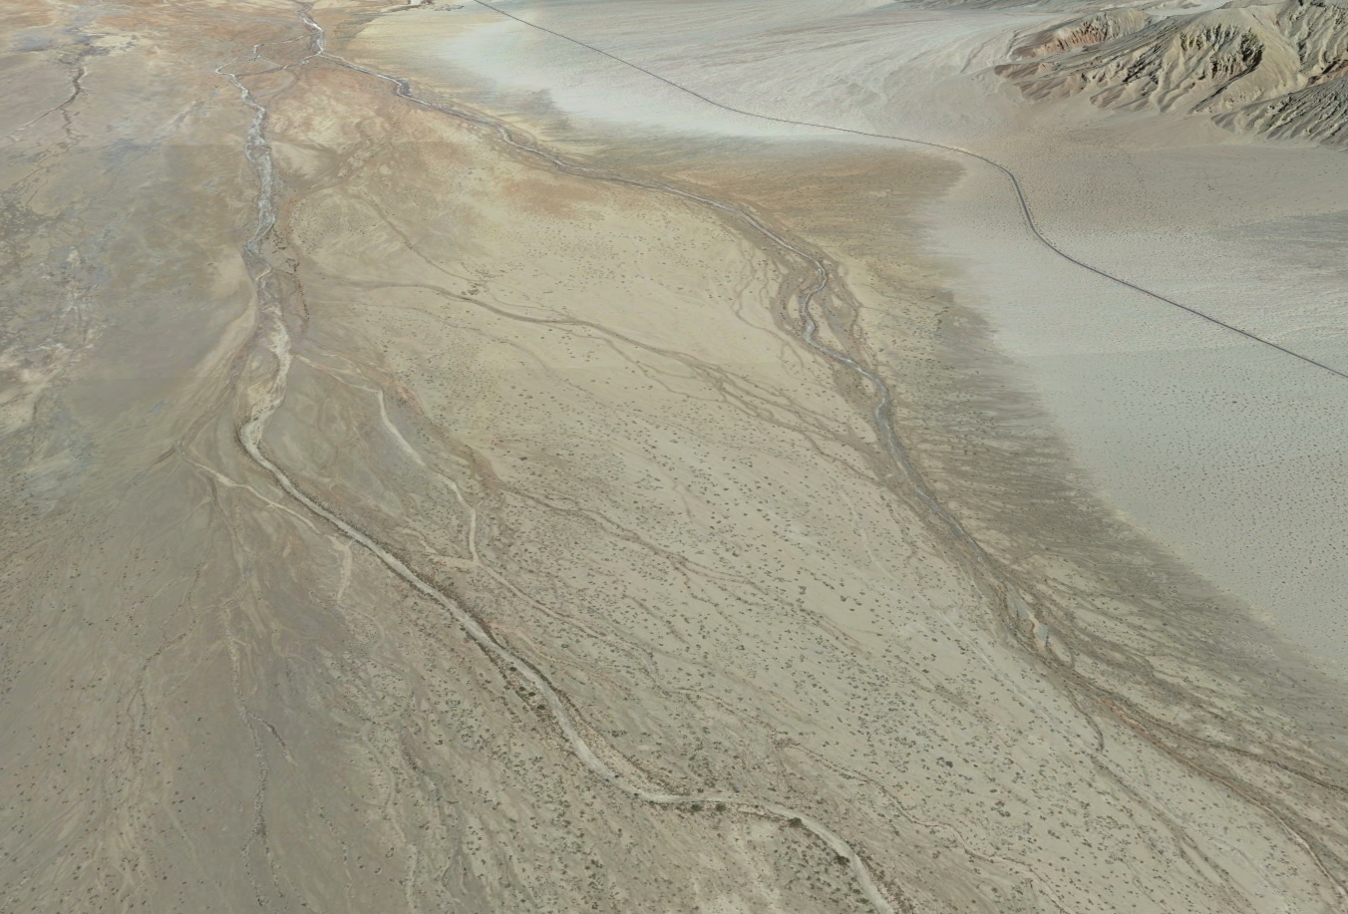
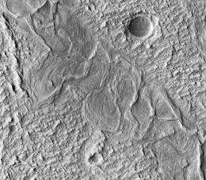
Introduction
N
Amargosa River, Death Valley
NASA/JPL/University of Arizona
What is a Meandering River? A single channel that is almost snake-like creating sinuous curves.
Meandering rivers here on Earth are typically held together by surrounding vegetation while on Mars they do not have vegetation. So, what is holding that together?
This project focuses on unvegetated meandering stream basins on Earth to better understand meandering rivers on Mars.
More specifically can salt concentration effect the stability of these channels.
Though we cannot test the surface hardness on Mars we are able to measure the thermal response of the surface.
Linking crust hardness and thermal response, we can test the relationship to determine if salt is a factor in Mars’ bank and surface stability.

Slide 3
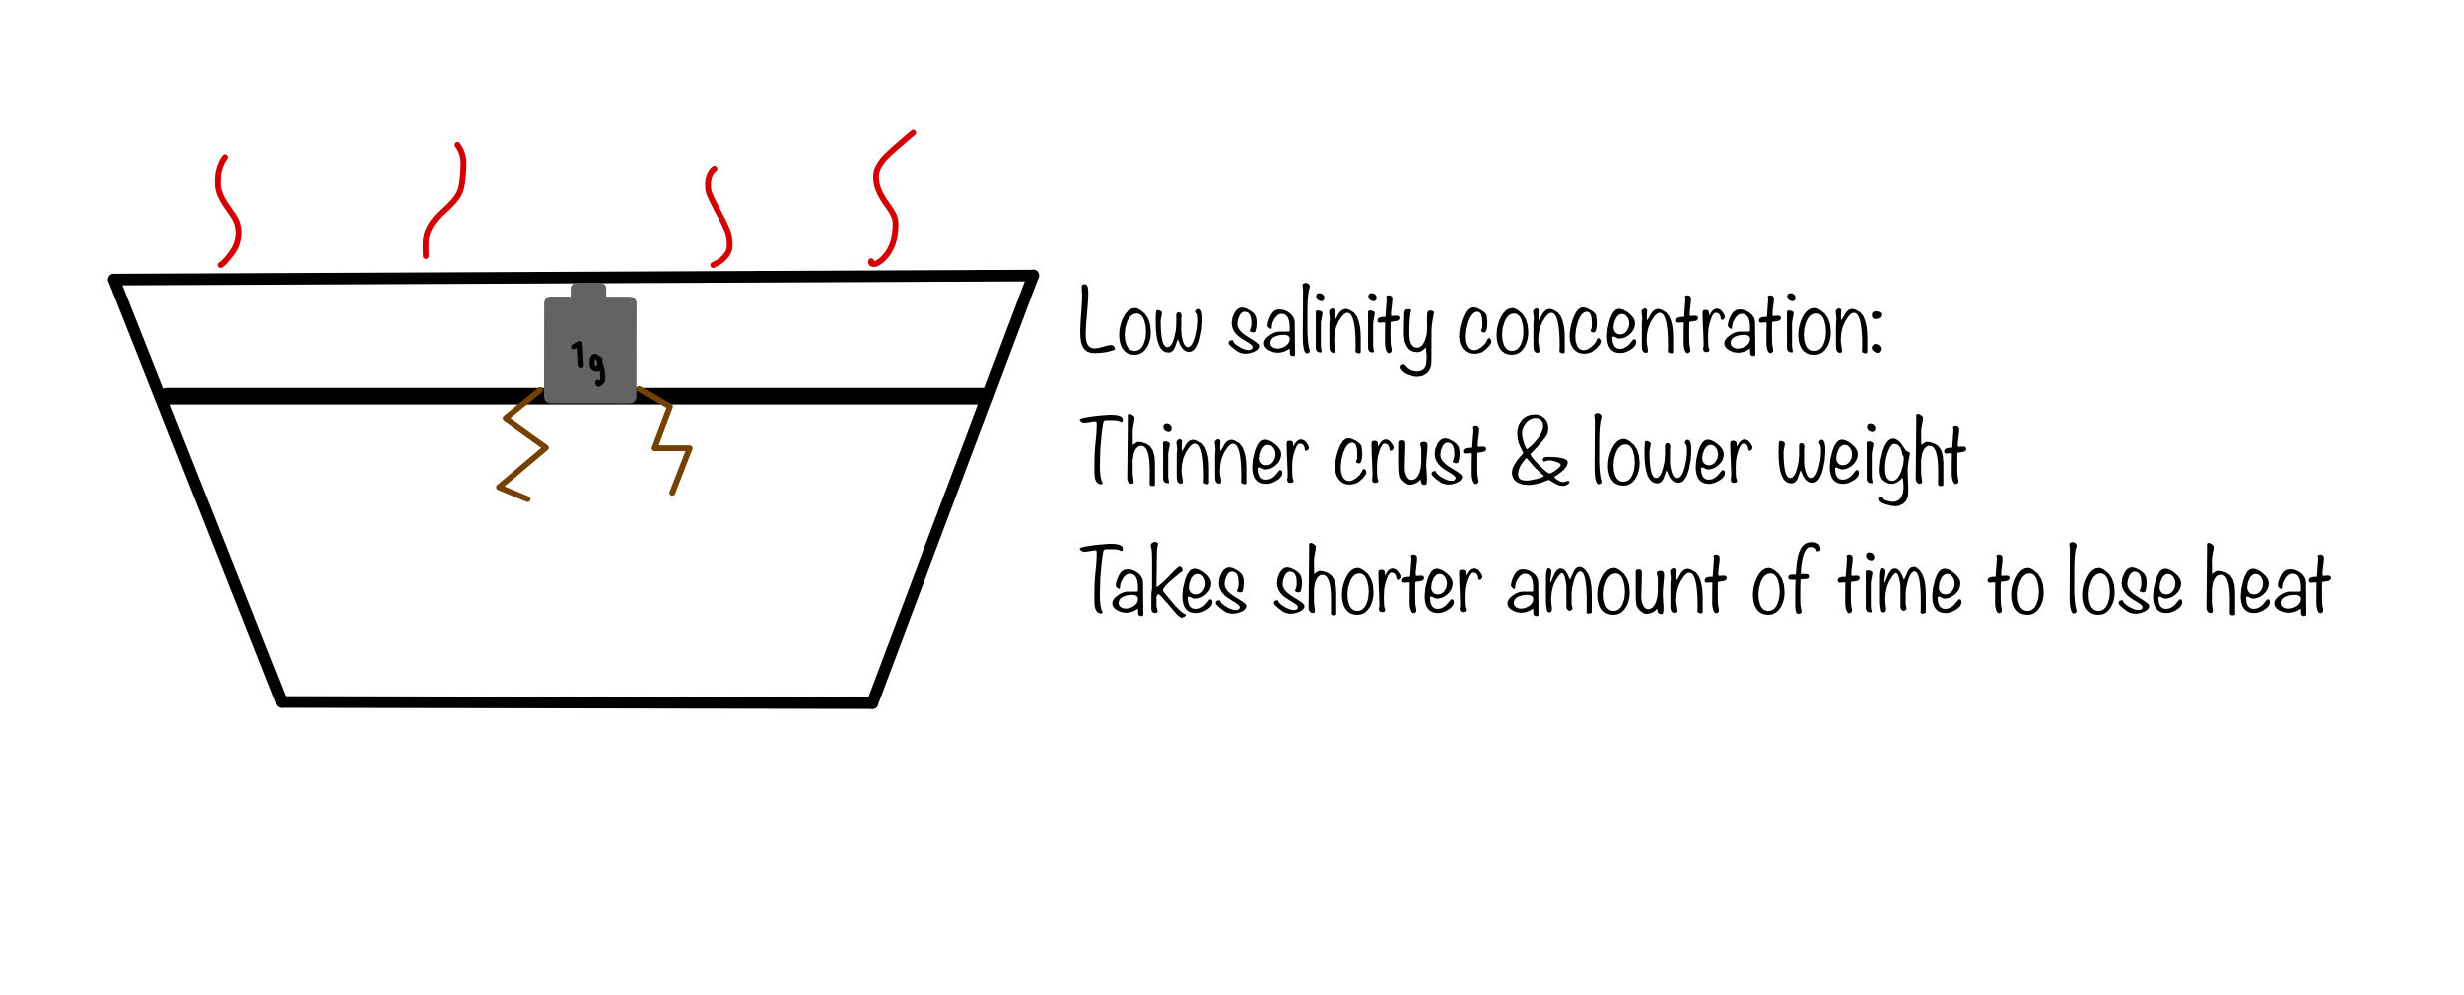
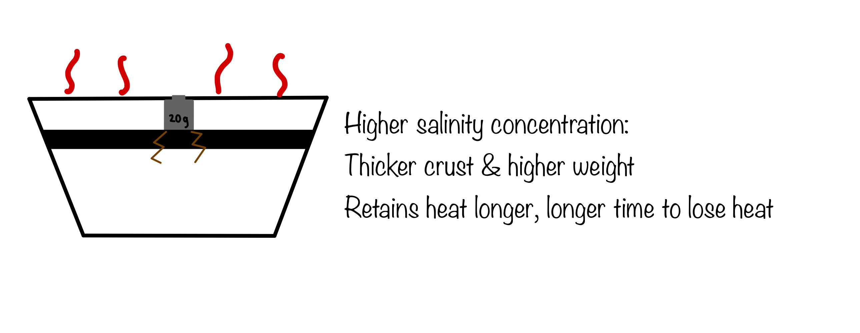
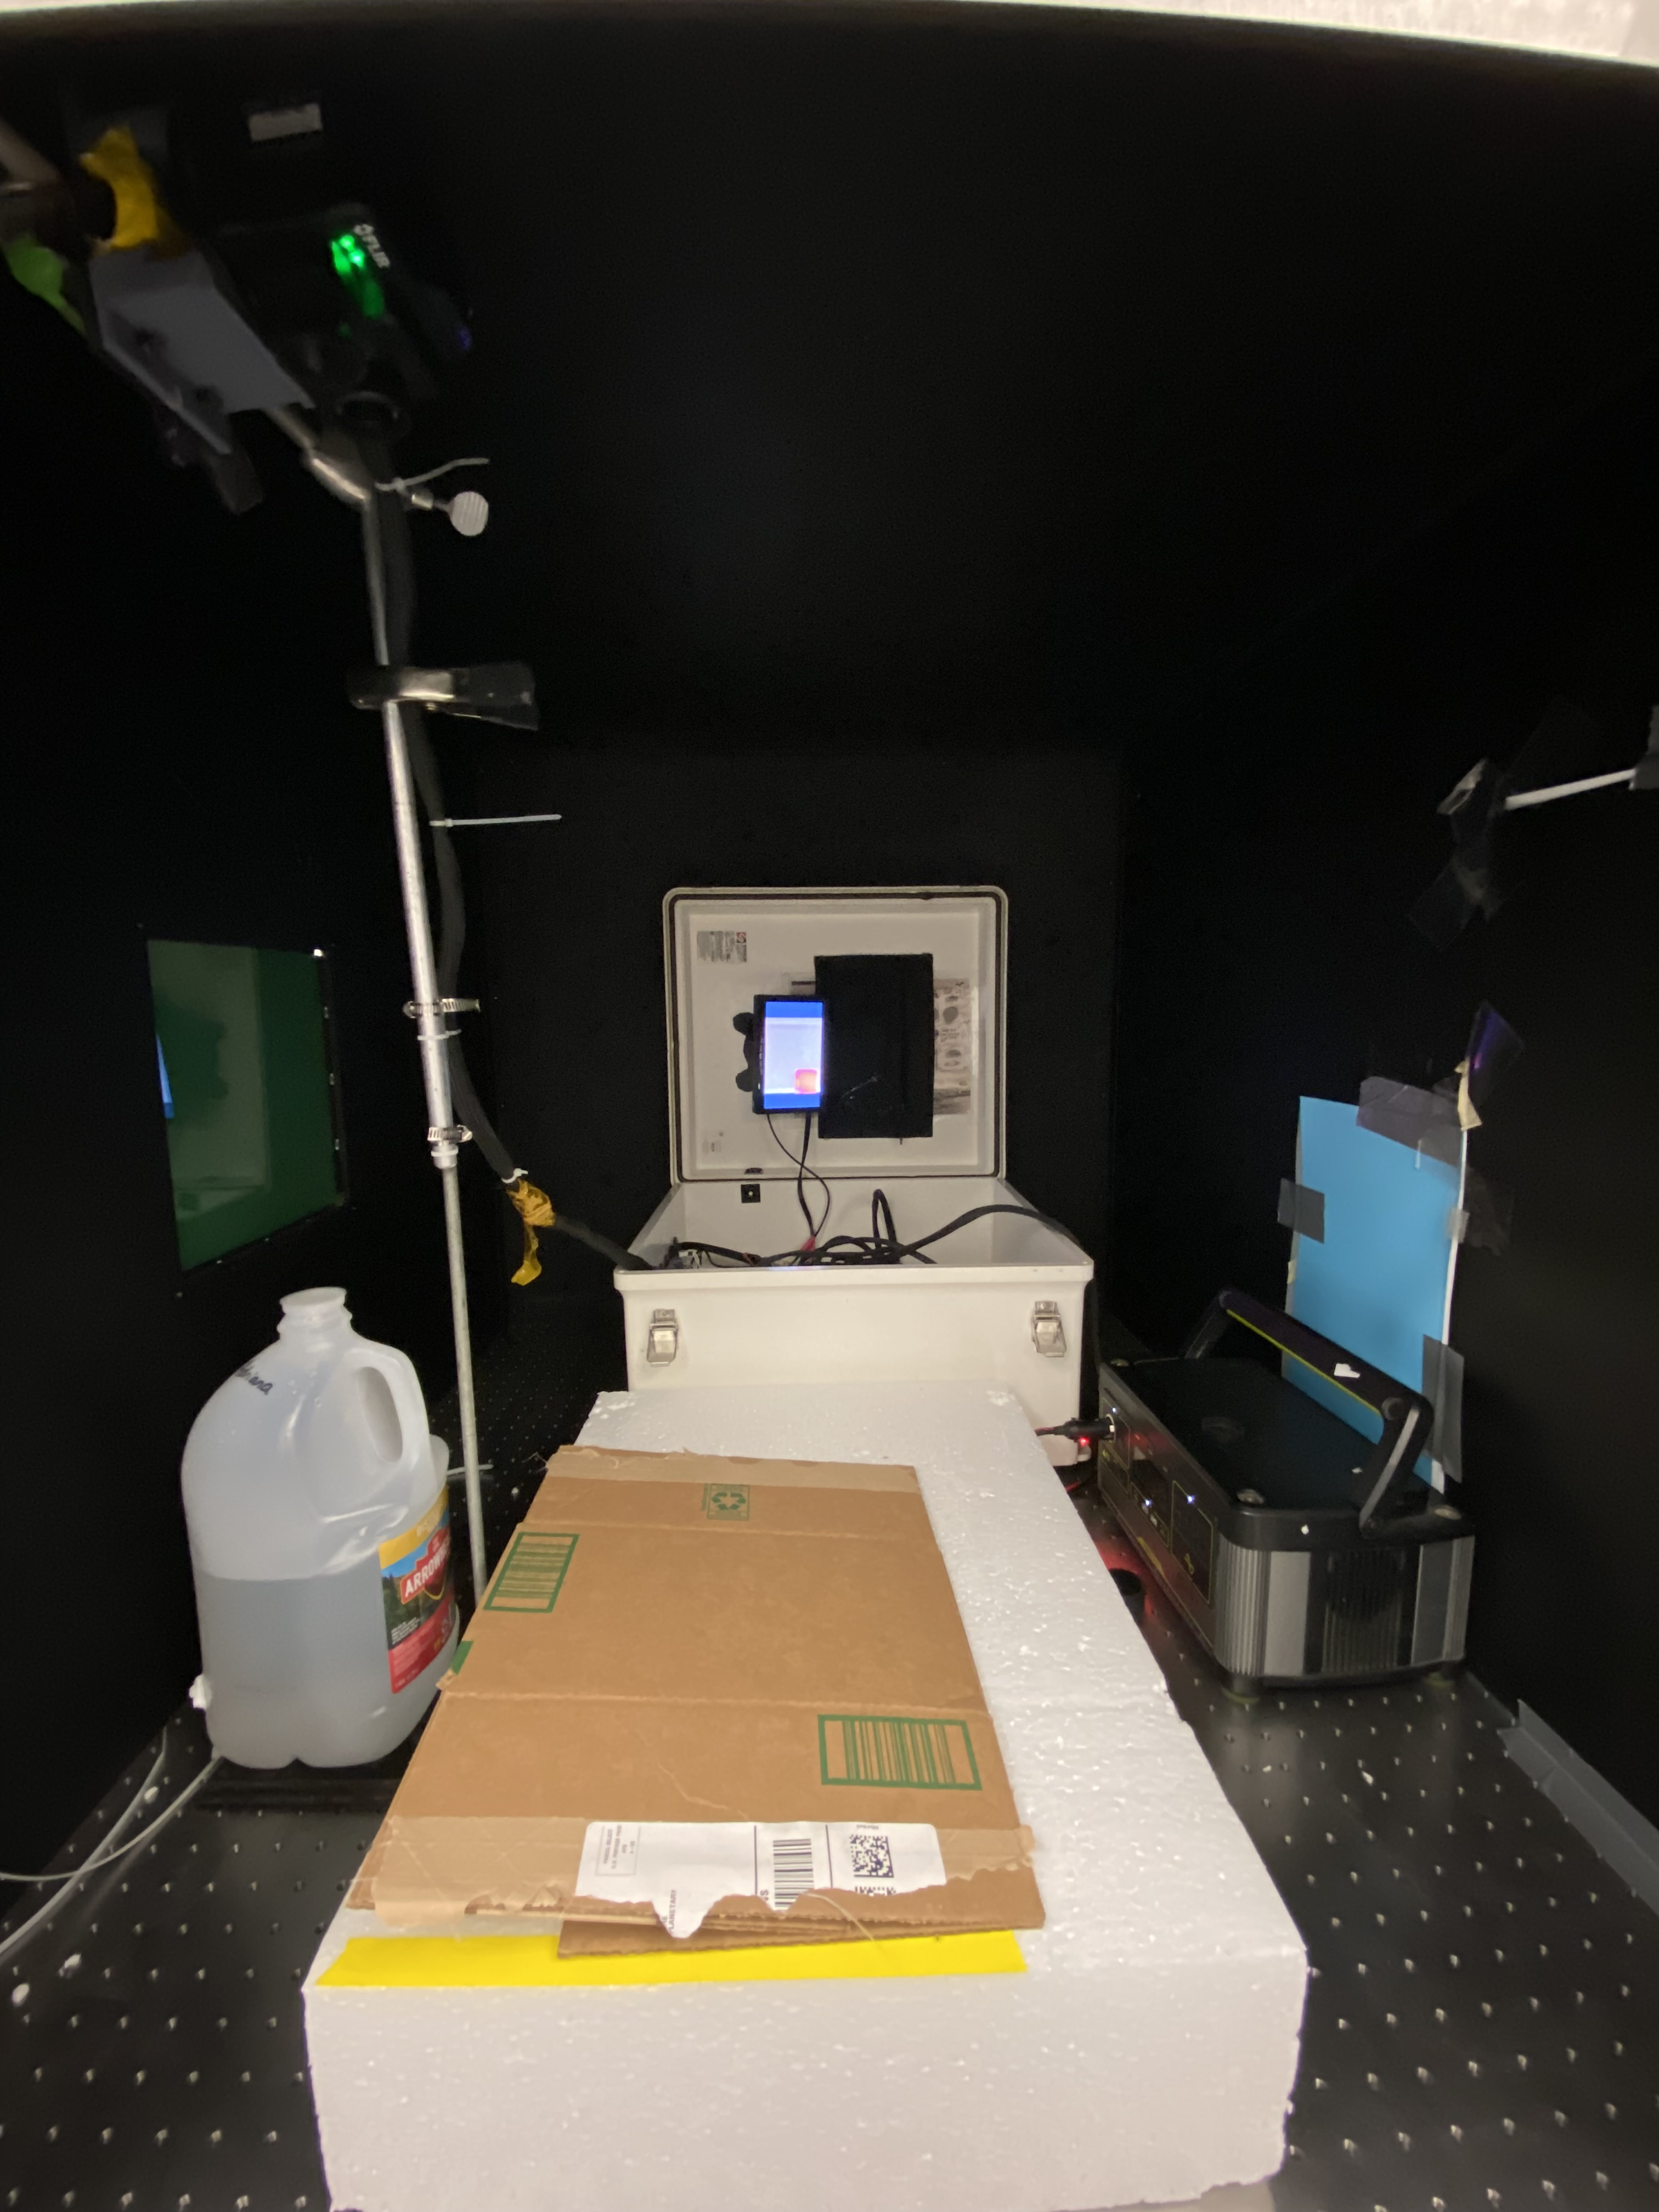
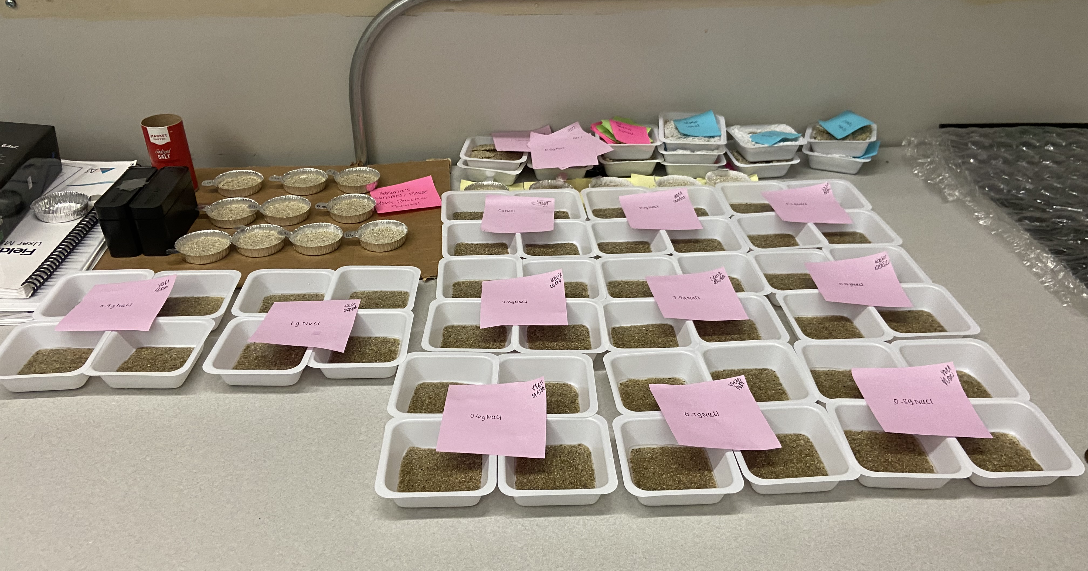
Methods- Two Salinity Tests
Salinity mixture to test crust hardness
    How: Creating salinity samples from 0%NaCl to 15%NaCl
    Why: To determine the average weight the concentrations of salinity can handle before breaking.
    Specifically looking for: cracking or denting on the surface of each sample
    Can we do this on Mars?: No.
  Trial and error run before main tests: due to high levels of salinity, samples were unable to fully dry out. This observation helped determine the correct range to use for final samples.
Thermal Images
  How: FLIR (Forward Looking InfraRed) Camera
  The FLIR camera takes thermal images measuring the temperature changes in various intervals, for this project it was every 15 seconds for one hour.
  Why: To determine if a specific salinity concentration would retain heat longer than another.
  Specifically measuring: What salinity percentages retain heat longer
  Can we do this on Mars? YES!
Large dark box that fits all the equipment and to prevent any outside forces to interrupt the experiment- such as sunlight, other bodies and wind – all of these, if close to the camera frame would interrupt the data and may skew it.

Slide 4
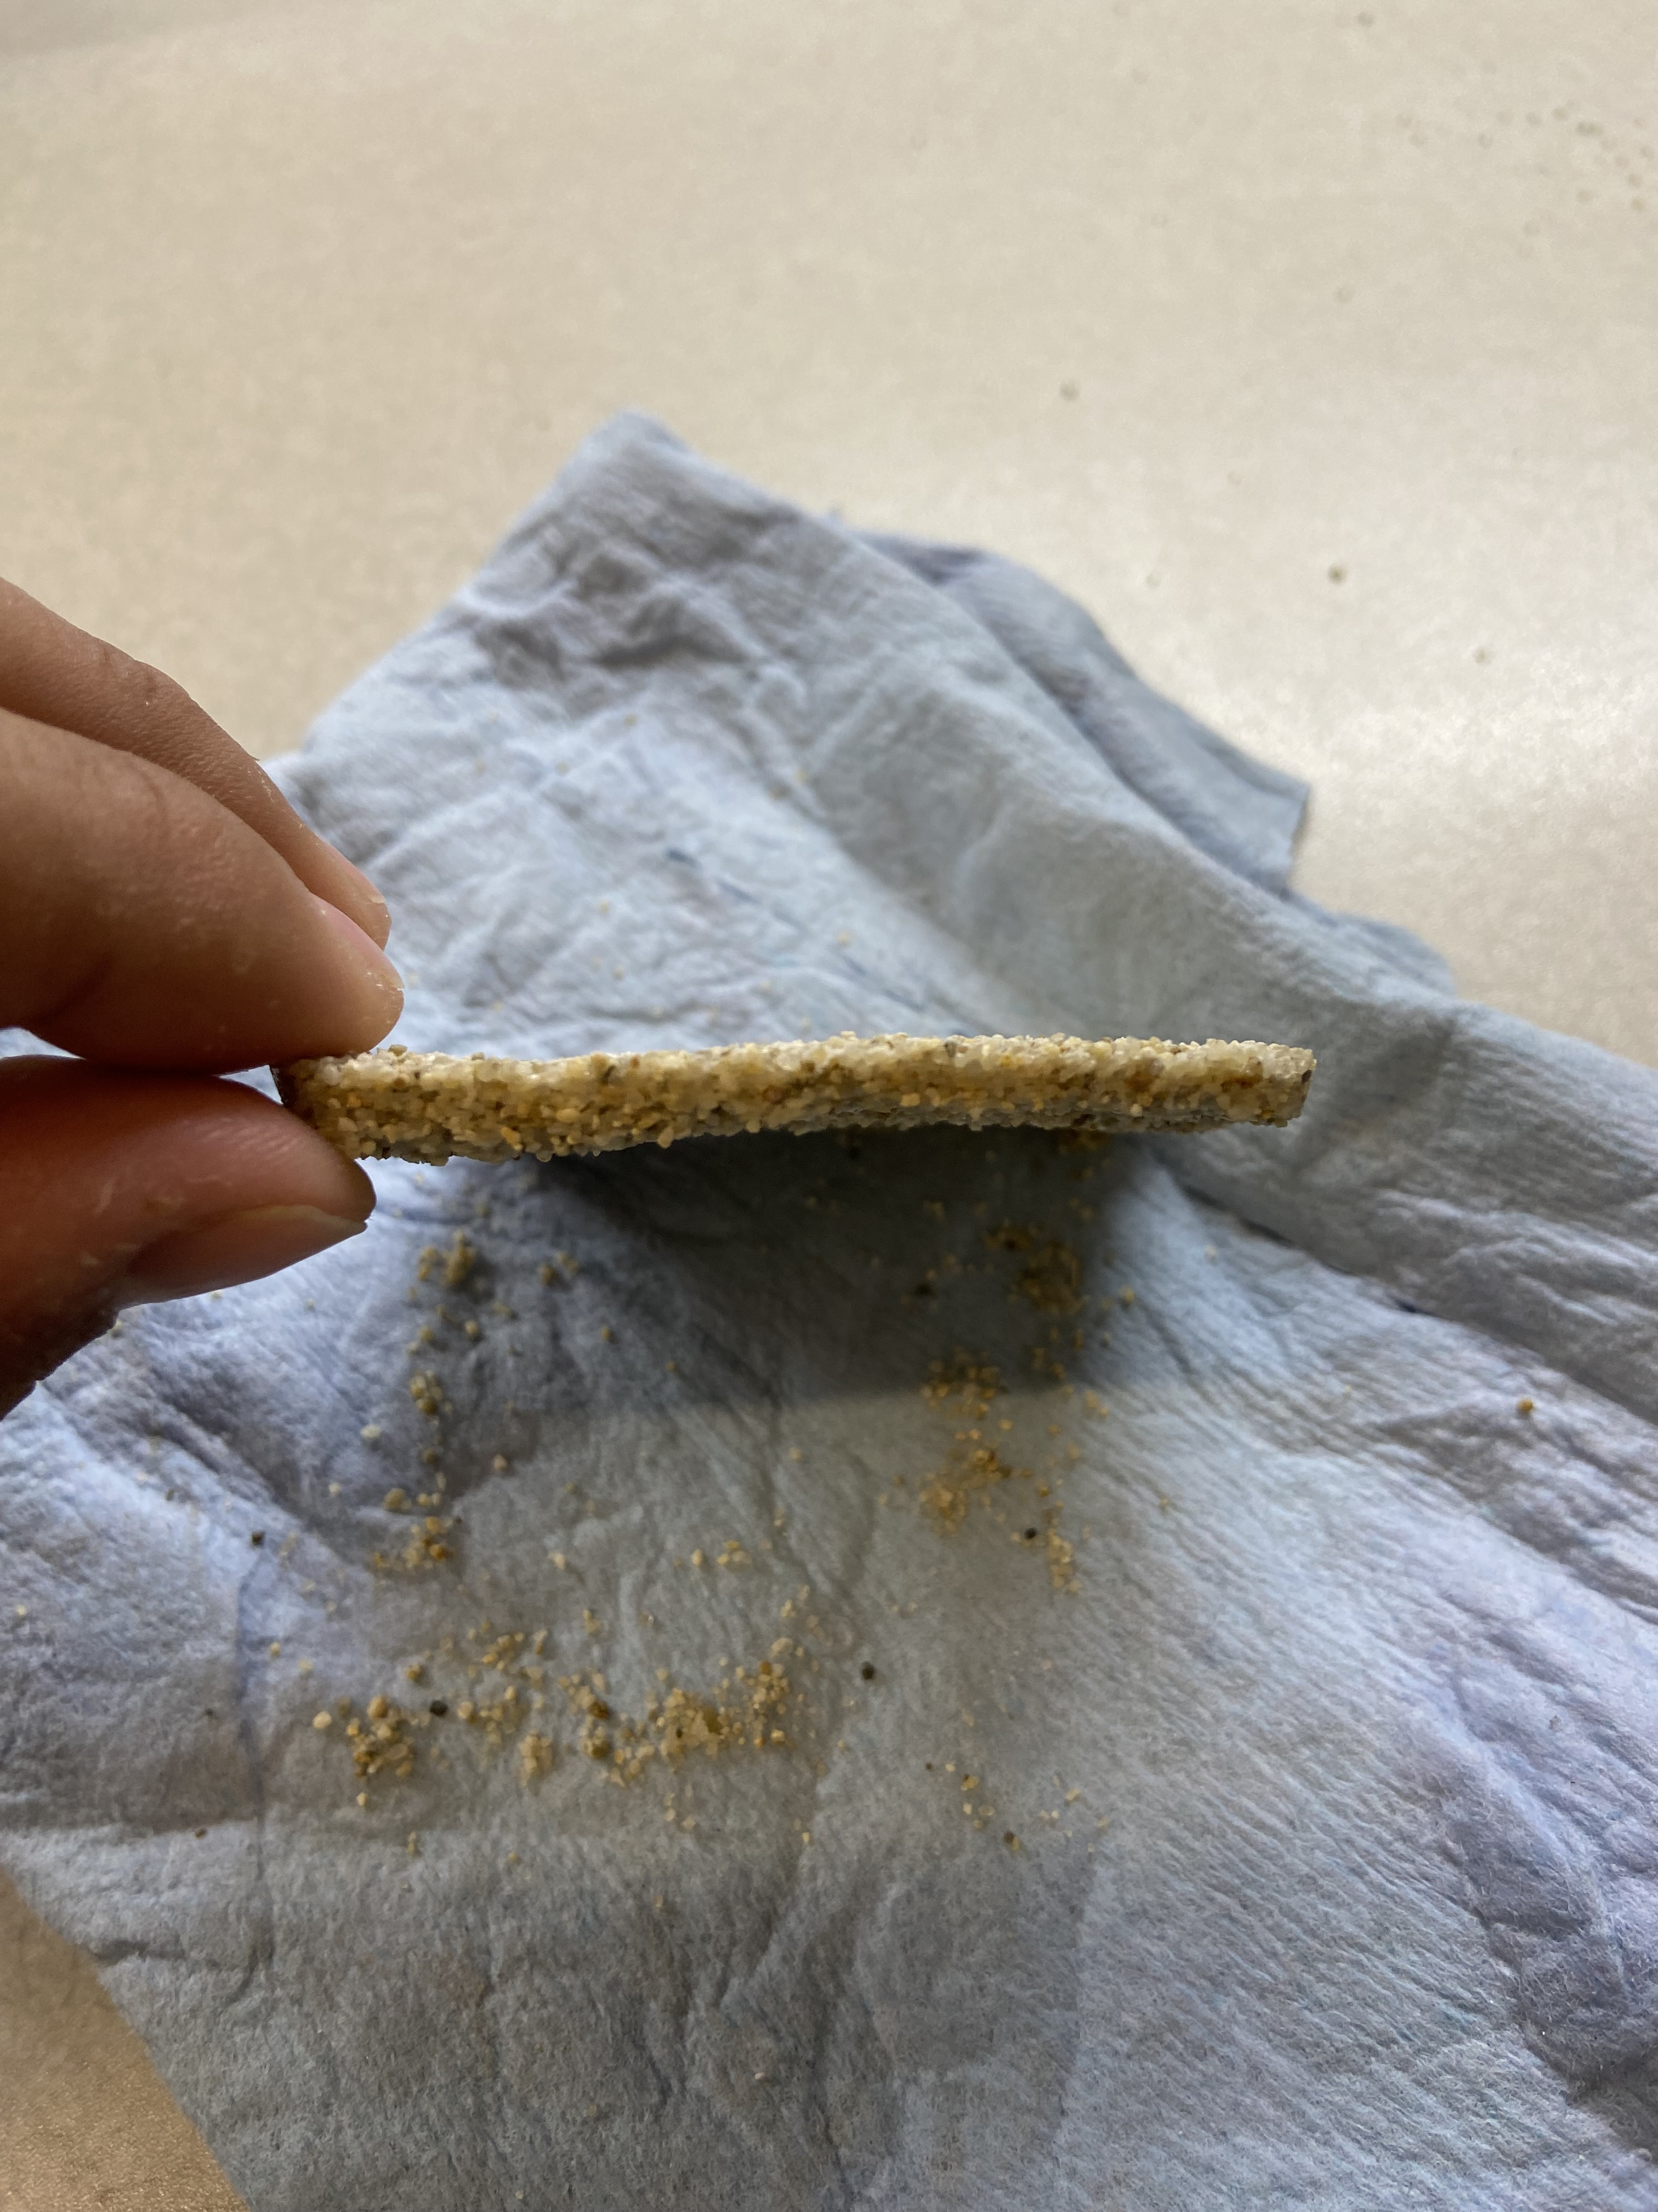
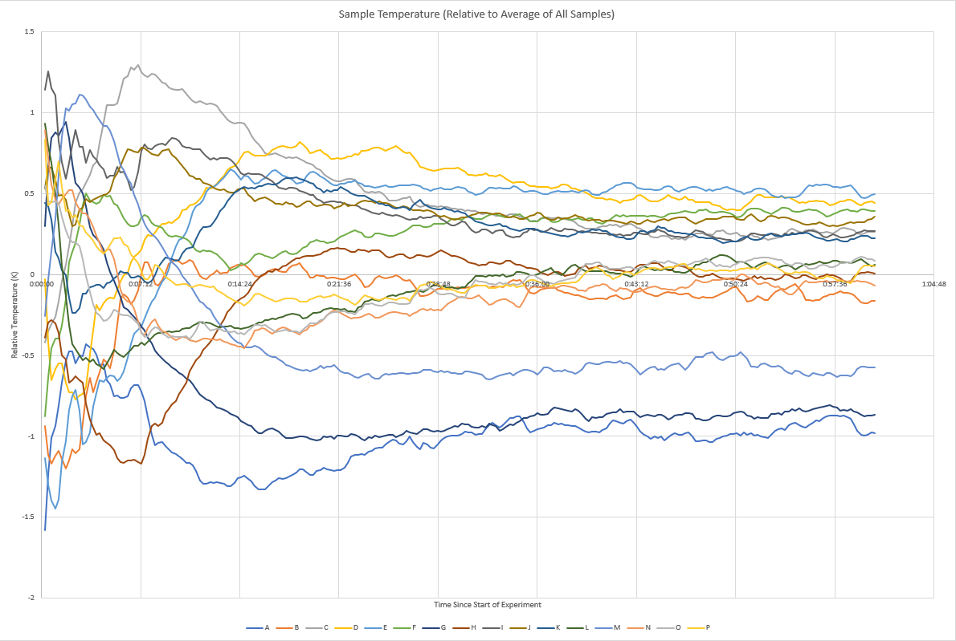
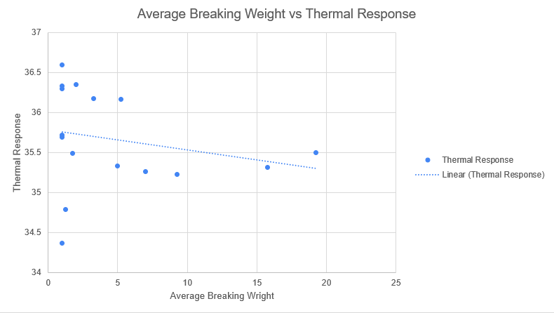
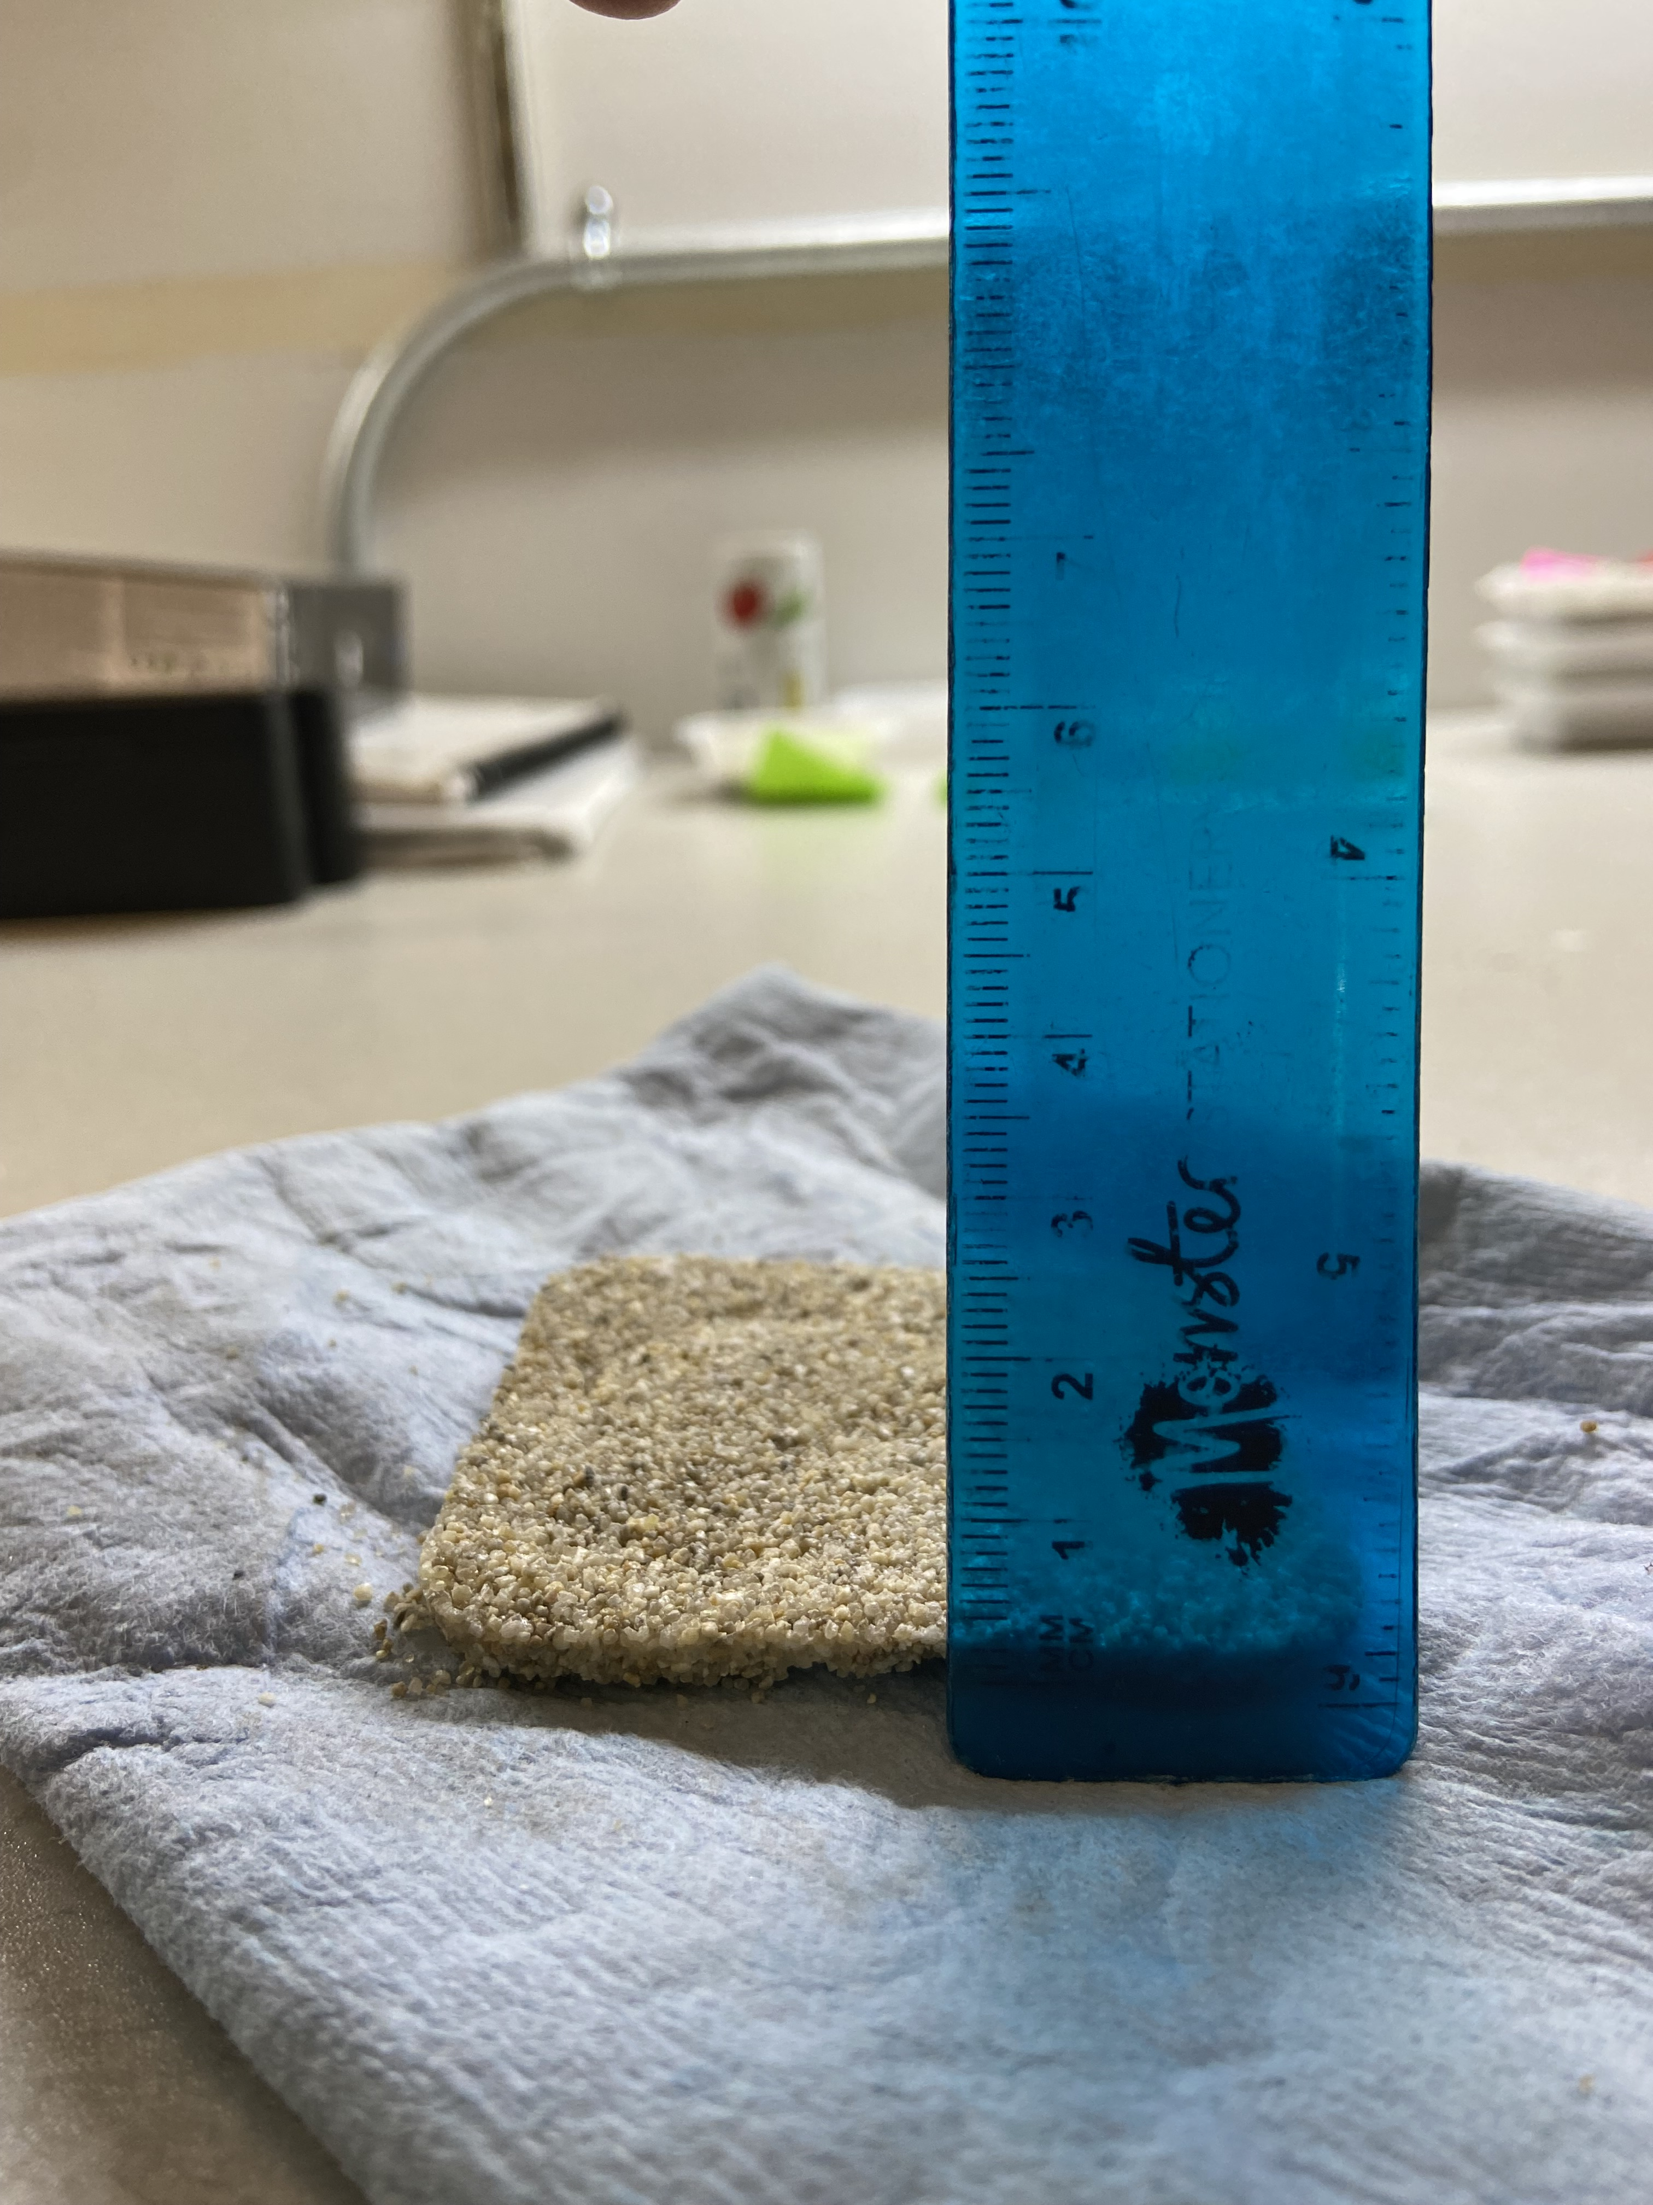
Results

Slide 5
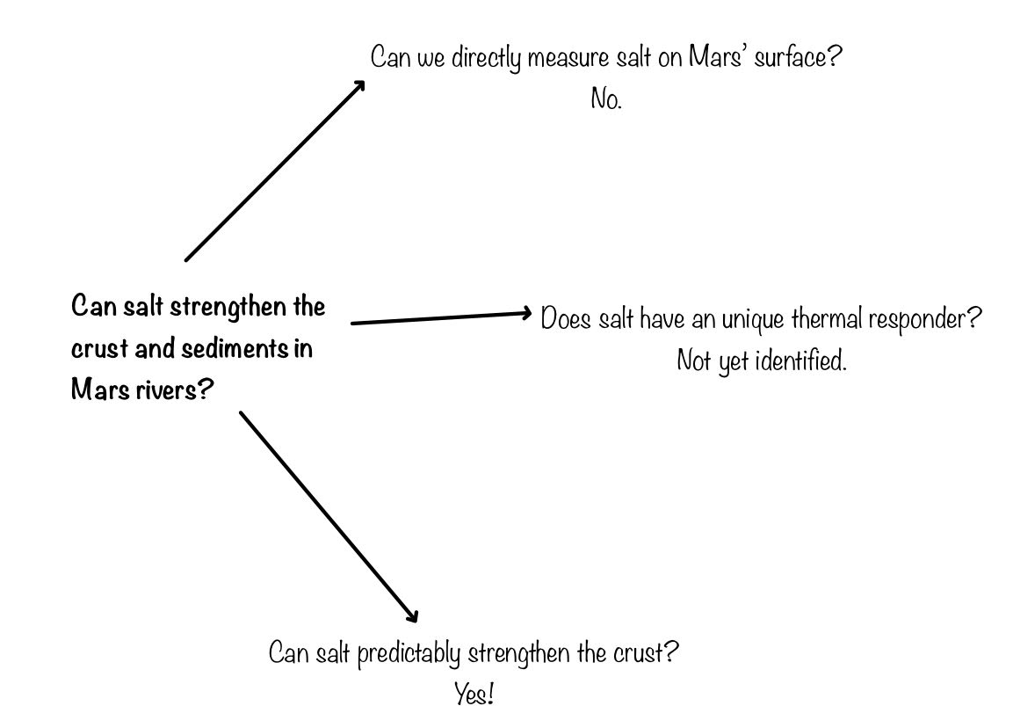
Discussion
Original Motivation- to get a better understanding of meandering rivers on Mars.
Due to the lack of vegetation on Mars, what then can be holding those basins together? Biology? Mineral Composition? Salinity Concentration?
My work- salinity concentration could be a possible contender. Knowing that there are salt deposits on Mars this can be a possible reason to what is holding together meandering stream basins since there is no vegetation

Slide 6
Conclusions
Is there a relationship between salinity and cool down time and hardness?
Based off the experiments, there can be a possible relationship between thermal response and crust hardness.
Measuring the thermal response of Mars’ surface overtime is a key factor when putting these together based off the cool down time in relation to salinity
More work surrounding thermal response and crust hardness is needed to determine if there is a correlation.

Slide 7
Special thanks to The Arizona Space Grant Consortium, NASA, and Mark Salvatore for his mentorship. I would also like to thank Ari Koeppel, Natalie Jones and Dr. Devon Burr for their guidance throughout this project.

Slide 8
Thank you!

